Slide 1
ERTS Final Assessment – Task 1 (Template)
Harry Liu - fx19583
Stephanie Lin - pt19585
Daiyun Chen - mt20768
(There is detailed comment describing the operation of the functions and codes in the code file)

Slide 2
Practical elements
Show that the robot can move around effectively in both modes of operations
The program first lets the user press switch 1 or switch 2 to select auto or free motion mode respectively [mode_selection()]
IF switch 1 is pressed -> SKYBLUE LED turned on suggesting auto mode selected
Let the user press switch 1 or switch 2 again to select interrupt or polling
IF switch 1 is pressed -> auto mode with interrupt (mode 1)
ELSEIF switch 2 is pressed -> auto mode with polling (mode 2)
ELSEIF switch 2 is pressed -> PINK LED turned on suggesting free motion mode selected
Let the user press switch 1 or switch 2 again to select interrupt or polling
IF switch 1 is pressed -> free motion mode with interrupt (mode 3)
ELSEIF switch 2 is pressed -> free motion mode with polling (mode 4)
then enter the function that is designed for the specific mode [entering_mode()]
mode 1 and 3:
The function has an infinite while loop that lets the robot walk continuously in a predefined route (auto mode) or straight line(free motion mode).
Because interrupt is enabled by EnableInterrupt(), whenever a bump switch is pressed, the robot immediately stops (auto mode) or turns direction (free motion mode).
mode 2 and 4:
The function has an infinite while loop that is executing the code sequentially, It runs the code one by one, first it checks for bump, then moves in a straight line
Because the interrupt is disabled by DisableInterrupt() in the function entering_mode(), robot will not immediately stop or turn direction when a switch is pressed.
The robot will only stop or turn direction when the execution of the predefined route is finished meanwhile one of the bump switch is still pressed down.

Slide 3
Practical elements
Show that you have made use of the LED & Switches
Red light: motor stops
White: moving forward
Blue: turning right
Yellow: turning left
Green: moving backward
Sky Blue: auto mode selected
Pink: free motion mode selected
Is there any difference in operation when you robot works in polling mode and interrupt mode?
In Interrupt, the motor immediately stops(auto mode) or changes direction(free motion mode) when bump switch is hit
In Polling, the motor shows a delay in stopping or change in direction when bump is pressed because the program runs the code sequentially, where it only checks for the bump after the prefined route’s execution is finished for every loop.

Slide 4
Interrupts
How do you implement operation of robot with polling? Why?
First, turn off the interrupt handler function by using DisableInterrupt()
Using an infinite while loop that runs the code sequentially (checks for bump...runs predefined loop..checks for bump again, runs predefined loop again...)
When checking bump switches, it checks bump 1-6 one by one.
How do you implement operation of robot with interrupts? Why?
First, turn on the interrupt handler function by using EnableInterrupt()
Using an infinitewhile loop that runs the predefined route
When a bump switch is detected as pressed, immediately goes to the PORT4_IRQHandler function and stops or change direction.
How have you kept the ISRs minimal?
Clear and memory stack after each interrupt
Disable interrupt when polling is used

Slide 5
Delays
Where have delays been used? Why?
In the mode_selection function, SysTick_Wait10ms(100) is used to prevent the user pressing too fast between the first time and the second time when selecting modes.
Used in mode 3 and 4 when changing direction of the robot, Motor_StopSimple(25) is used to slow down the turning process.

Slide 6
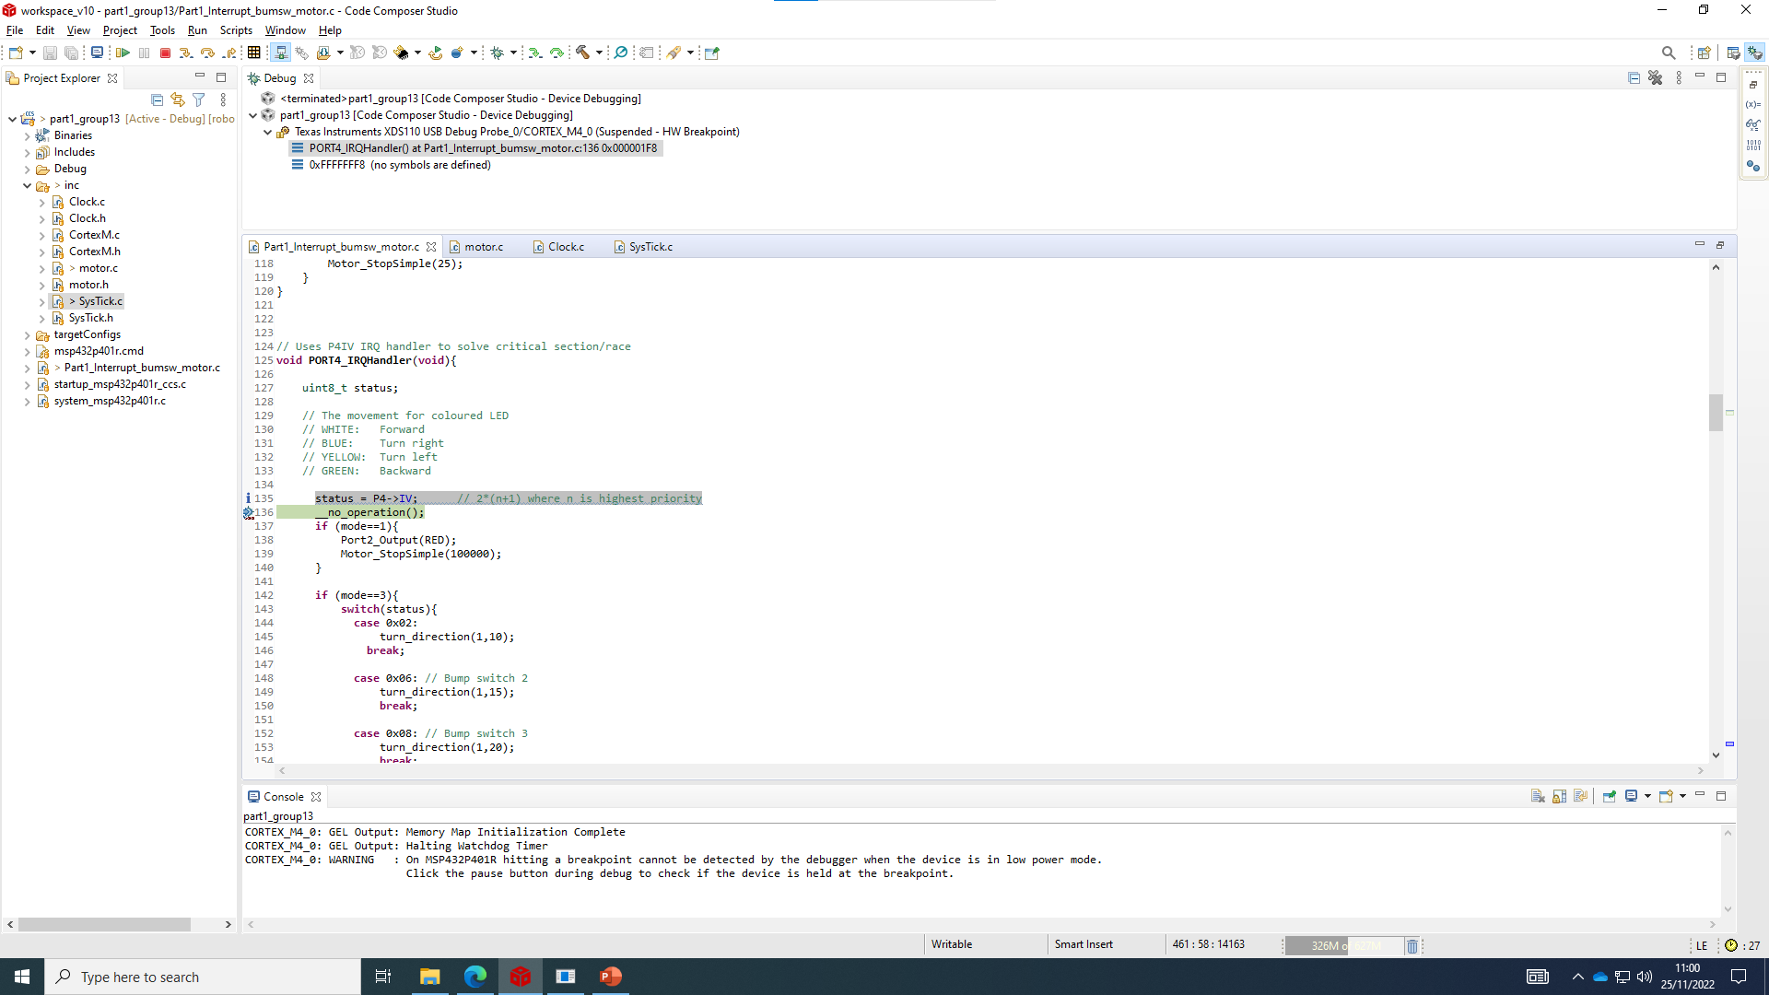
CPU Usage
Latency between main function and Port4_IRQHandler function (27 clock cycles)

Slide 7
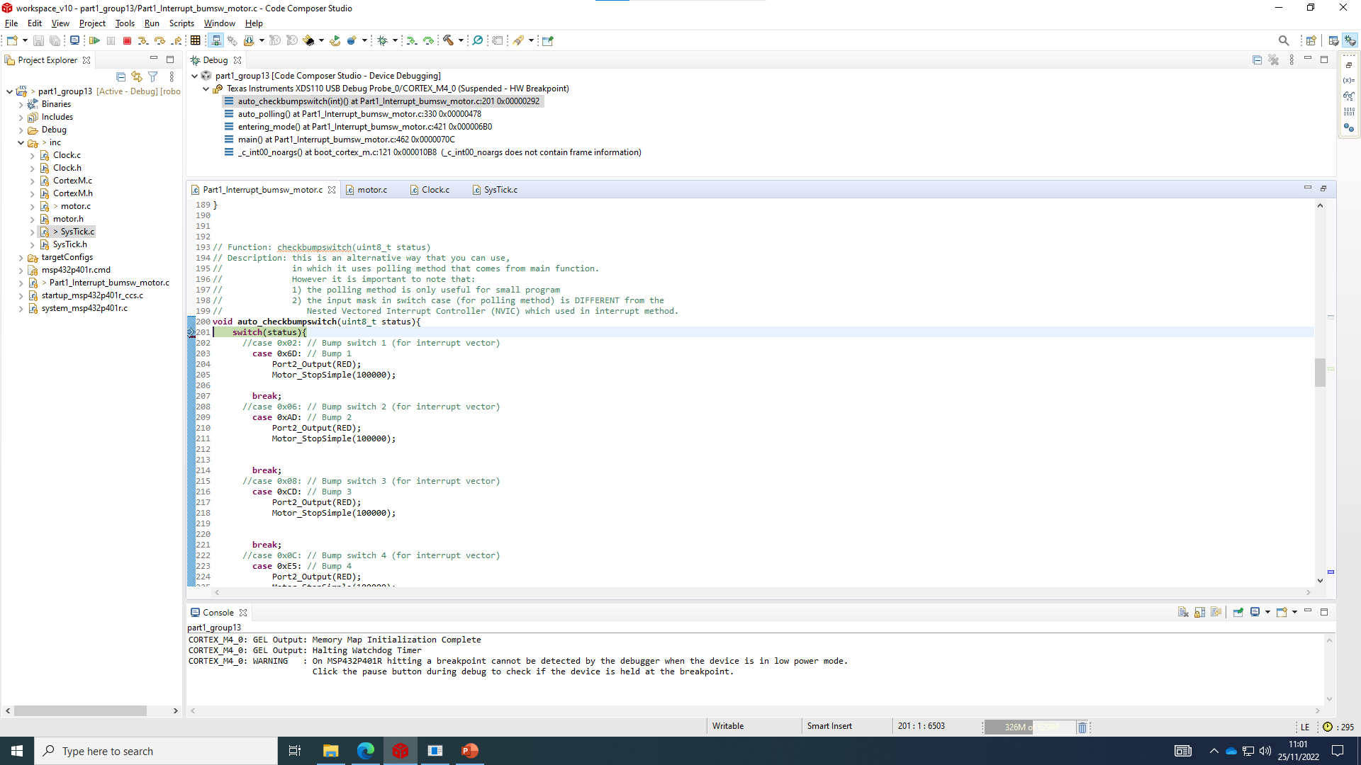
CPU Usage
Latency between main function and checkbumpswtich function (295 clock cycles)

